Slide 1

TeachMeSensei: Use of Technology to strengthen Communication between communities
By:
Divya Chainani
Pratik Kumar Gadhiya
Siddhartha Lakhar
Madhushudhan Reddy Jakkula
Hemanchal Joshi

Slide 2

CONTENTS
INTRODUCTION
PROBLEM STATEMENT
SOCIAL ANALYSIS
METHODOLOGY- Design Thinking
PROTOTYPING
DEMONSTARTION

Slide 3

INTRODUCTION
The idea of the project:
Why a Skill development application?
People want to learn many things but cannot do it due to many constraints (I.e. time, money, age, society) .
People want to share their talent but lack platform
People need more communities with common interest
To strengthen communication of like-minded people
Why TeachMeSensei?
Idea to build teaching and learning-platform.
Sensei means Teacher in Japanese and is a widely recognized term
The name suits the idea

Slide 4

PROBLEM STATEMENTS
Existing applications
Why choose TeachMeSensei Over them?
Meetup
Social networking application
Works on the basis of user's interest
Arrange large events
Send out ads
The Coast
Web based Portal
Information on upcoming events
Allows small-scale workshops (I.e. even one-on-one if necessary)
Allows the involvement of skilled users without professional experience
Timing and Scheduling benefit
Near-by location access
Beneficial for skilled students and homemakers
Allows members to request for an event unlike in Meetup.
Vs

Slide 5

SOCIAL ANALYSIS
Preparation of Questionnaires (use of Google forms)
Taking consent
Goal oriented questions
Non-personal questions
Multiple choice questions
Walk through the Ethics board
Made sure all participants do not fall under any kind of restrictive groups
Take consent from ethics board
Survey and Research
Distribution of google forms
Personal interviews within the university

Slide 6
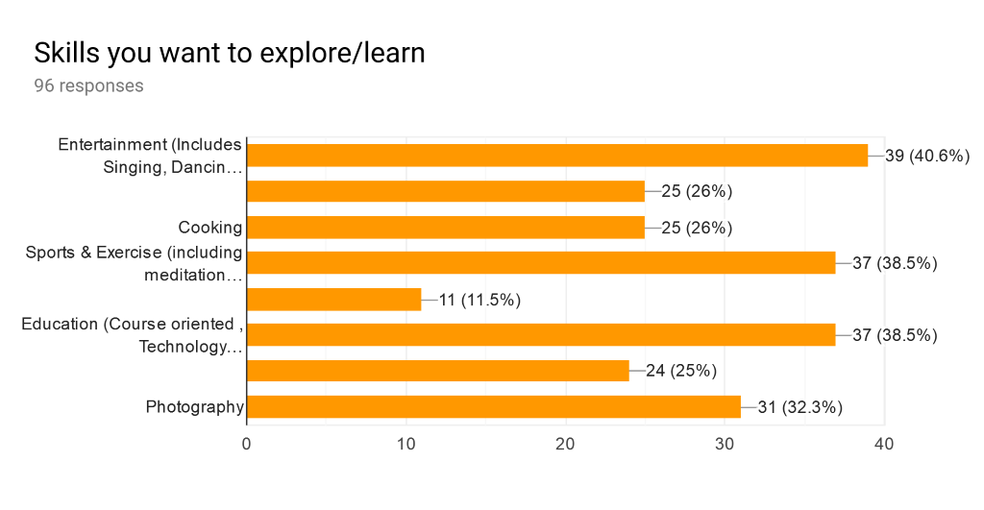
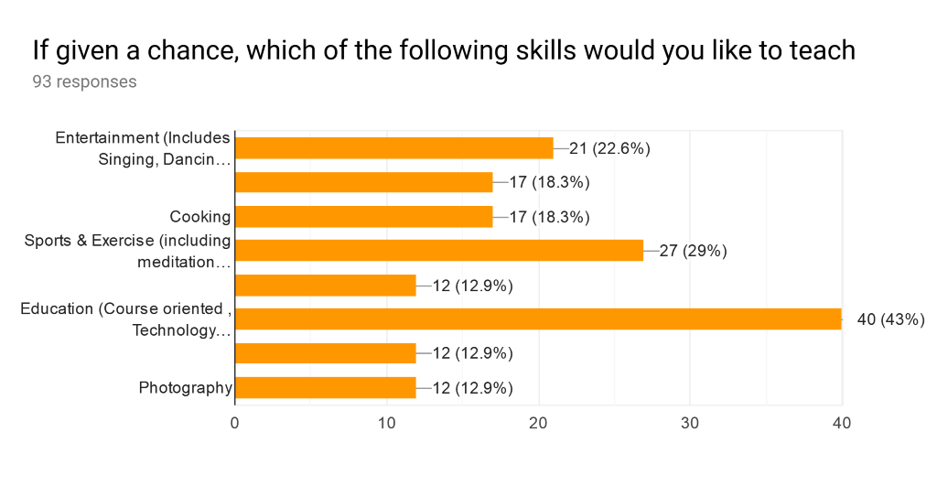
SOCIAL ANALYSIS contd...
Results and Evaluation
Most participants between 18-28 years of age
Most participants interested in Entertainment field (I.e. music, dance etc.)
Ready to learn or tutor and share their skill if given chance
Shows feasibility of the proposed application
Does their requirements match the goal of TeachMeSensei?
Participants want an application which allows them to teach and learn without any certification at their convenience.
Listed out user requirements can be the features of TeachMeSensei
So, yes we are headed in right direction

Slide 7

METHODOLOGY- Design Thinking
Persona creation
Empathy Map
AS-IS Scenario leading to Ideation

Slide 8
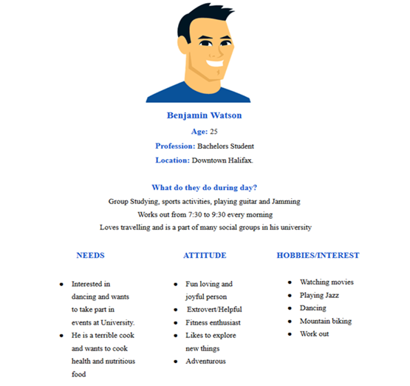
Persona Creation
Created imaginary persona
Listing down needs and requirements
Thinking from persona's perspective
PROBLEM STATEMENT
Wants to learn dancing for performing at his sister’s wedding and is looking for tutor

Slide 9
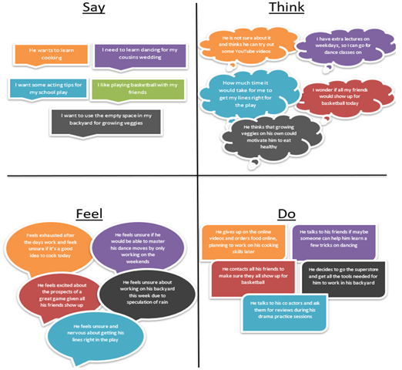
Empathy Map
Allows us to think feel and perform as a
End-user as well as a Developer
Describes the required thoughts and actions of the end user

Slide 10
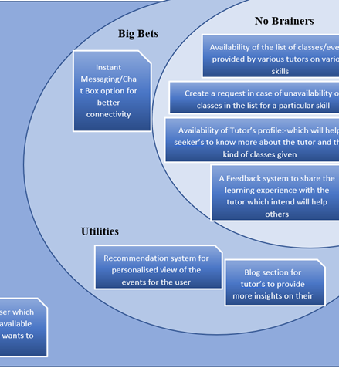
AS-IS Scenario leading to Ideation
AS-IS scenario
Derived from the empathy map
Breakdown problem statement to meet user-requirements
Ideation
Intersection of end-user and developers needs and requirements
Categorizing into no-brainers, big-bets, utilities and unwise
Pinning out pain points and no-brainers
Excluding Unwise

Slide 11
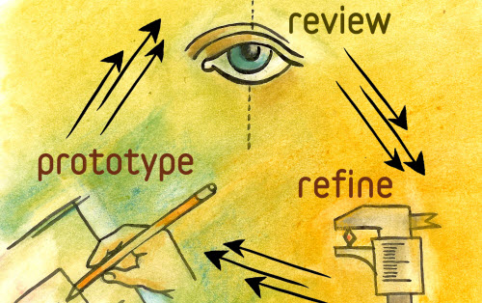

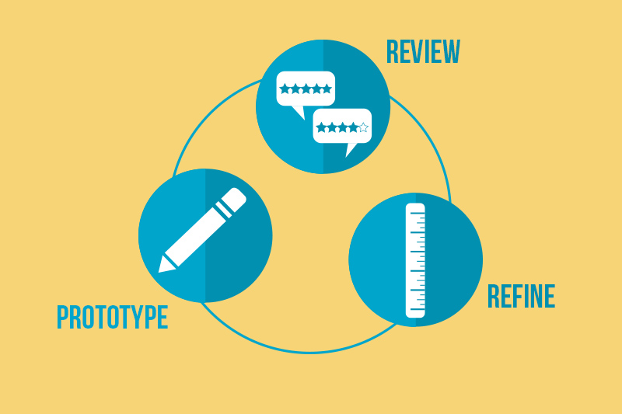
PROTOTYPING
Initial prototype
Heuristic Evaluation and Issues
New Prototype
Usability Testing

Slide 12
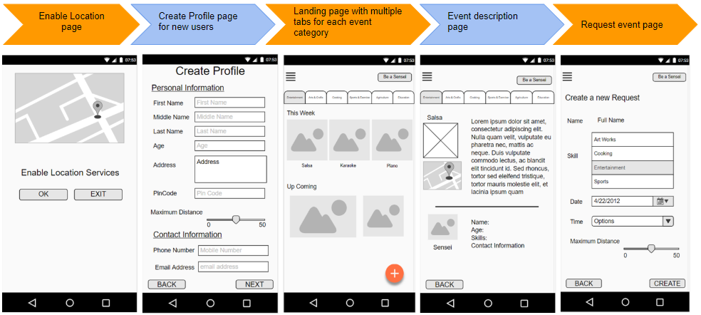
INITIAL PROTOTYPE

Slide 13
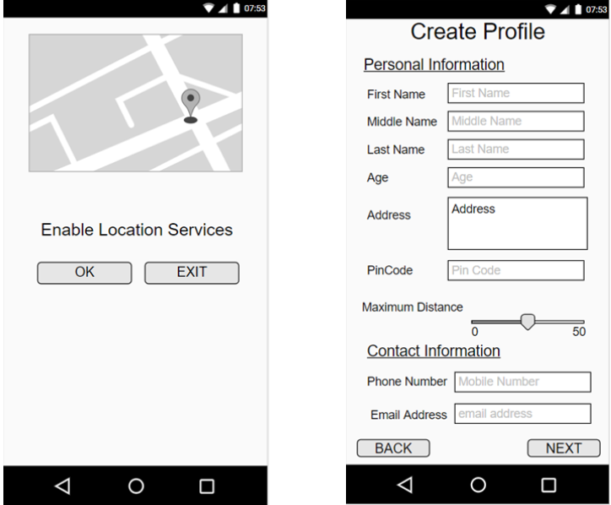
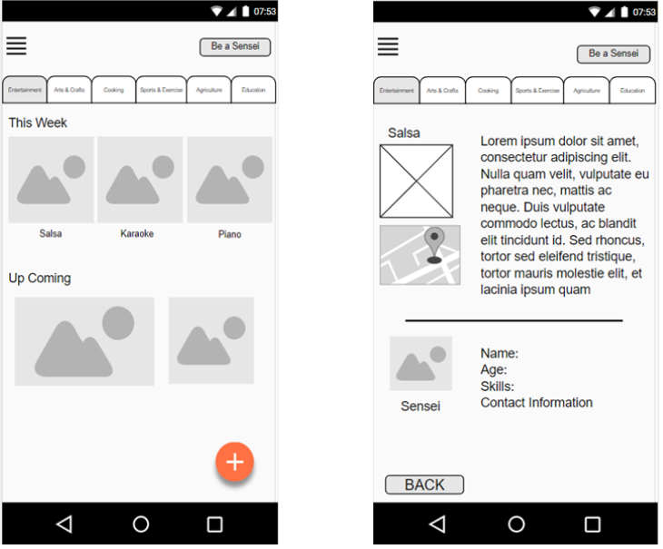
Heuristic Evaluation and Issues
What’s wrong ?
Why was location used?
What does maximum distance state was not clear?
‘+’ symbol in the home page
to show the most recent events or classes happening near the user irrespective of any category of the event
Phone number should have drop-down with the extension and +1 to be set as default .
Communication with tutor was not possible
User was not able to logout from their profile.

Slide 14

Heuristic Evaluation and Issues contd....
How to make it better ?
Give a description of why the location is used
Replace maximum distance by range of tutor/student
Remove the ‘+’ button and add new button of ’Create request’
Show all the events happening nearby the user and then user can navigate through different categories of their choices
Add a drop-down country code list for phone number with default country code as +1 for canada
Chat option to be made available to contact the Sensei
Add a logout button.

Slide 15
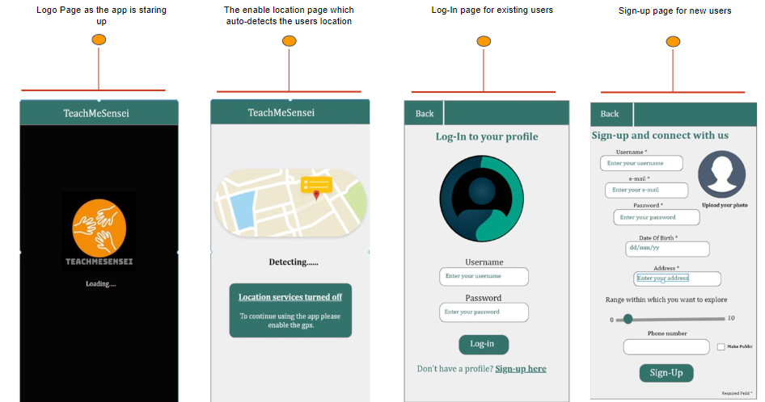
NEW PROTOTYPE

Slide 16
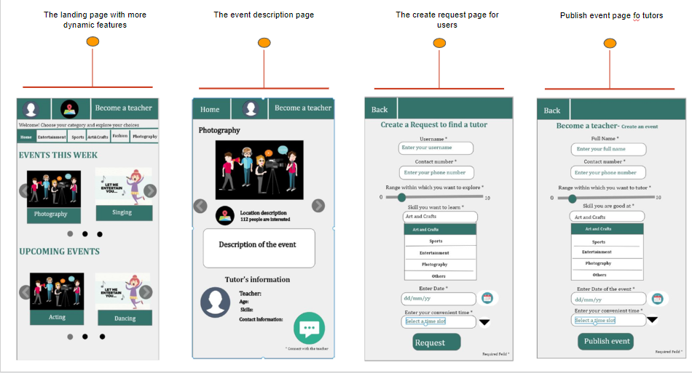
NEW PROTOTYPE contd...

Slide 17

USABILITY TESTING
Equipment used
Mobile phone
Laptop
Notebook
Pen
Methods
Task segregation
Observation
Time calculation
OBSERVATION:
The final prototype was easier to use, the users quickly understood the flow if app and took minimum time to explore the features.

Slide 18

LEARNINGS AND FINDINGS
Technology plays vital role to initiate communication between people from various perspectives
There are numerous ways of using technology to do so.
Designing involves solving any existing problem with innovative ideas.
While designing any such platform
One must gather data and requirements of users.
One must think from user-end's perspective first
One must intersect the needs of users with what designers and developers can give.
Team work always leads to solutions and findings.

Slide 19
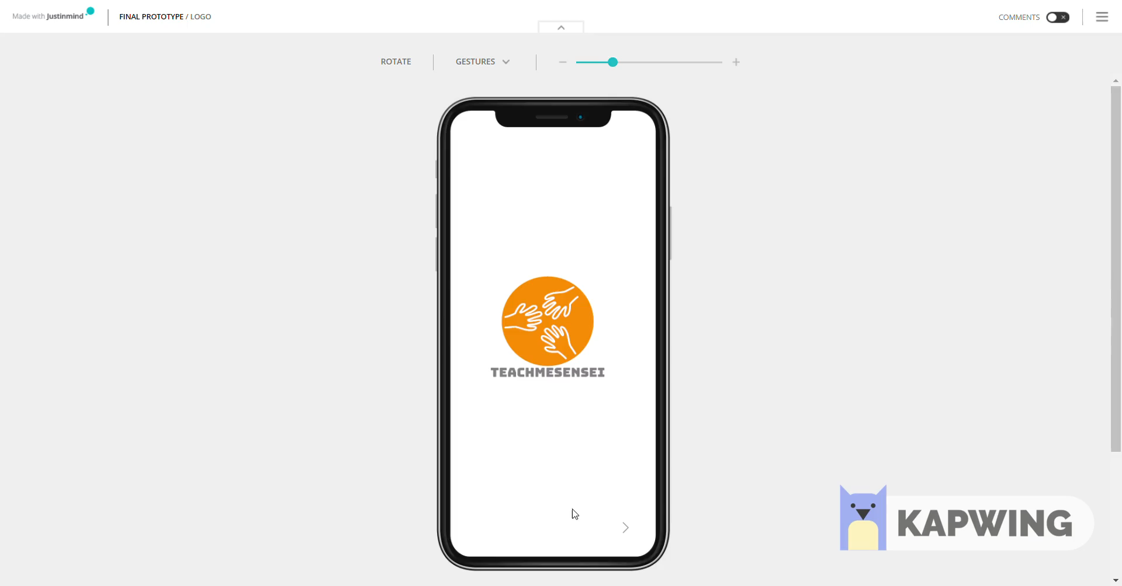

Slide 20

THANK YOU
Any Queries?

